Slide 1
Zion Infotech Solutions:
Zion Infotech is a leading provider of innovative technology solutions, specializing in delivering transformative results for businesses of all sizes.

Slide 2



About Us
Zion Infotech was founded in 2016 with a commitment to helping clients achieve their goals through the power of technology.
Mission
To empower businesses with cutting-edge solutions and exceptional service.
Vision
To be the trusted partner for all technology needs, driving innovation and growth.
Values
Integrity, excellence, collaboration, and customer satisfaction.

Slide 3
Company Overview
Zion Infotech provides a comprehensive suite of services, encompassing everything from strategy consulting to technical implementation.
Core Services Industries Served Global Presence
Web and mobile app development
Cloud computing solutions
Financial services
Zion Infotech has offices in major cities worldwide, serving clients across diverse industries.
Healthcare
Education
Data analytics and reporting
Retail
Cybersecurity and IT infrastructure
Manufacturing

Slide 4



WHAT MAKES US DIFFERENT?
Zion Infotech sets itself apart through a unique combination of expertise, innovation, and customer-centricity.
1
Experienced Team
Our team comprises highly skilled professionals with deep industry knowledge and a proven track record of success.
2
Agile Development
We embrace agile methodologies to deliver projects efficiently and adapt quickly to changing requirements.
3
Innovative Solutions
Zion Infotech is at the forefront of technological advancements, offering cutting-edge solutions to address complex challenges.
4
Customer Focus
We are dedicated to building long-lasting partnerships with our clients, ensuring their satisfaction at every stage of the engagement.

Slide 5
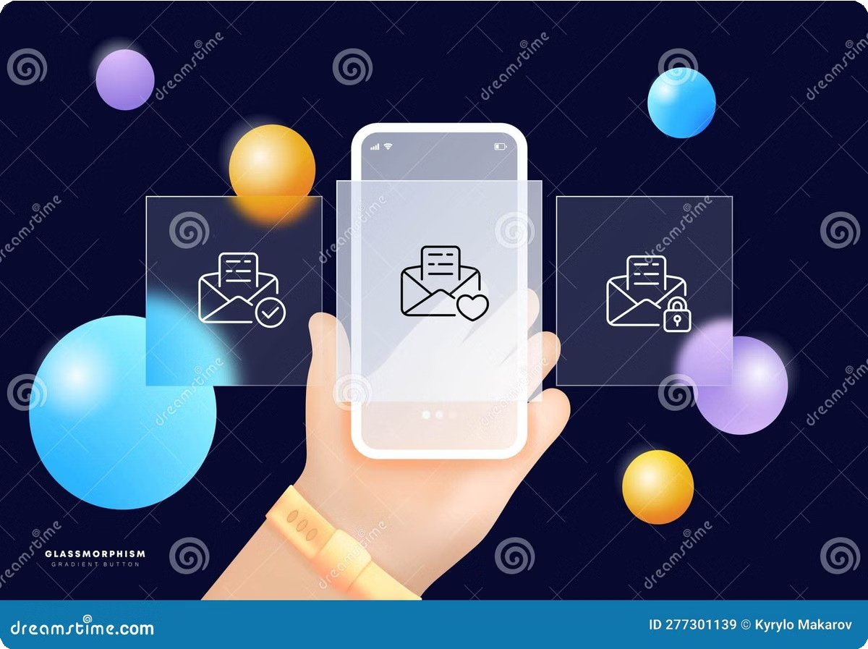
Media Contact Information
For media inquiries, please reach out to the contact information below.
Name | Email | Phone
Karan Kumar CEO | karan.kumar @zioninfotech.com | +91 816-866-9936

Slide 6


Our Team
Meet the dedicated team behind Zion Infotech Solutions. Our experts bring diverse skills and experiences to provide innovative solutions to our clients. Learn more about the individuals driving our success.
At Zion Infotech, we believe in the power of collaboration and teamwork. Our team members are passionate about technology and committed to delivering exceptional results for our clients. We foster a culture of continuous learning and growth, ensuring that our team stays ahead of the curve in the ever-evolving tech landscape.
Our team is comprised of highly skilled proMeet the dedicated team behind Zion Infotech Solutions. Our experts bring diverse skills and experiences to provide innovative solutions to our clients. Learn more about the individuals driving our success.fessionals with expertise in various domains, including web and mobile app development, cloud computing, data analytics, cybersecurity, and IT infrastructure. We leverage this diverse skillset to provide comprehensive solutions tailored to the unique needs of our clients.

Slide 7



Challenges and Solutions
Zion Infotech helps businesses address their most pressing challenges by providing tailored solutions.
Business Growth
1
We assist businesses in expanding their reach, improving efficiency, and increasing profitability through technology solutions.
Data Management
2
Zion Infotech helps organizations leverage their data effectively to gain valuable insights, make data-driven decisions, and improve operational efficiency.
Security Threats
3
We protect businesses from cyberattacks and data breaches through comprehensive cybersecurity solutions and services.
Digital Transformation
4
Zion Infotech guides businesses through their digital transformation journey, enabling them to embrace new technologies and stay ahead of the curve.

Slide 8


Marketing Solutions Services
Explore our cutting-edge marketing solutions services designed to enhance your brand visibility and engage a global audience. From email marketing to quality assurance, we offer comprehensive strategies to elevate your marketing efforts.

Slide 9


Email Marketing Strategies
Unlock the power of personalized email campaigns to connect with your audience on a deeper level. Our tailored email marketing solutions drive engagement and deliver results to help you stand out in the digital landscape.
Quality Assurance Process
Our quality assurance process ensures your email campaigns are flawless. We meticulously test and refine every aspect, from subject lines to content, to maximize deliverability and impact. Our team of experts monitors performance and makes real-time adjustments to optimize your results.
Reach a Global Audience
With our advanced geotargeting capabilities, we can help you craft email campaigns that resonate with audiences around the world. Our multilingual support and cultural expertise ensure your message is delivered effectively, no matter where your customers are located.
Powerful Utilizations
Our email marketing platform leverages cutting-edge technologies and data analytics to unlock the full potential of your campaigns. From dynamic content personalization to advanced automation, we provide the tools and insights you need to drive measurable results.

Slide 10

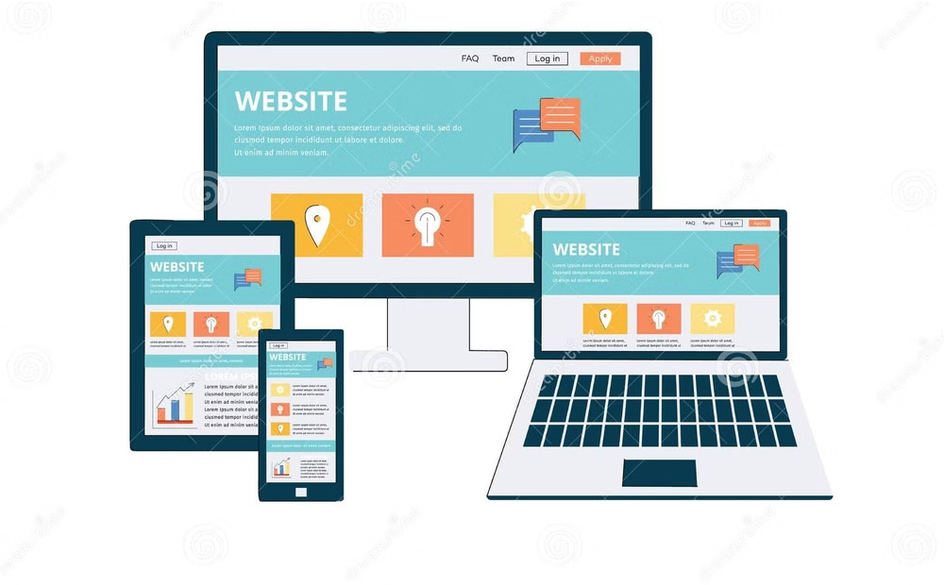


Case Studies
Explore our case studies to see how Zion Infotech has helped clients achieve remarkable results.
Website Redesign
Zion Infotech helped a leading retailer revamp their online presence, increasing website traffic and sales by 30%.
Mobile App Development
We developed a mobile app for a healthcare provider that streamlined appointment scheduling and improved patient engagement.
Data Analytics Platform
Zion Infotech built a data analytics platform for a financial institution that enabled them to identify key trends and make informed investment decisions.

Slide 11


Managing Suppressions
At Zion Infotech, we take a meticulous approach to managing suppressions and maintaining the health of your subscriber lists. Our rigorous quality assurance process and data enrichment insights ensure your email campaigns remain compliant and deliver maximum impact.
Comprehensive List Hygiene
We continuously monitor your subscriber data, identifying and removing invalid, unengaged, or unsubscribed contacts. Our advanced algorithms and verification tools, combined with data enrichment, keep your lists clean and up-to-date, reducing bounce rates and improving deliverability.
Proactive Suppression Management
Our team proactively manages your suppression lists, handling bounces, unsubscribes, and spam complaints in real-time. We utilize industry-leading tools and best practices, along with data enrichment insights, to ensure your campaigns avoid reaching blacklisted or blocked recipients, protecting your sender reputation.
Regulatory Compliance
Zion Infotech is committed to helping you navigate the complex landscape of data privacy regulations. We leverage data enrichment to ensure your suppression and opt-out processes adhere to GDPR, CAN- SPAM, and other applicable laws, safeguarding your business and your customers' trust.

Slide 12



Our Vision
Zion Infotech is dedicated to shaping the future of technology and empowering businesses to achieve their full potential.
Innovation
We are constantly pushing the boundaries of technology to deliver groundbreaking solutions.
Leadership
We strive to be at the forefront of the industry, setting the standard for excellence.
Collaboration
We value teamwork and believe that working together leads to the best outcomes.
Sustainability
We are committed to responsible and sustainable practices, ensuring a positive impact on the environment and society.

Slide 13




Our Mission and Services
Zion Infotech is committed to providing high-quality technology solutions that meet the unique needs of our clients.
1
Strategy Consulting
We help clients define their technology strategy, identify key opportunities, and develop a roadmap for success.
2
Solution Design and Development
Zion Infotech designs, develops, and implements customized solutions to meet specific business requirements.
3
Project Management and Implementation
We provide expert project management to ensure timely and efficient delivery of projects, meeting all quality standards.
4
Support and Maintenance
Our team provides ongoing support and maintenance to ensure the smooth operation of technology solutions and address any challenges.

Slide 14
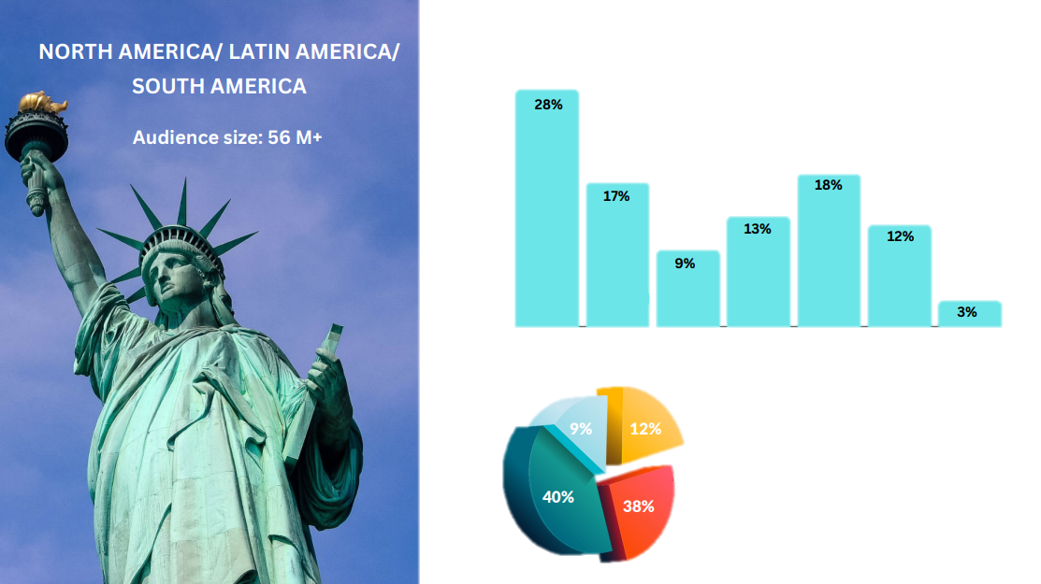
30%
COMPANY SIZE
25%
20%
15%
10%
5%
0%
JOB LEVEL
C-LEVEL
DIRECTOR+
MANAGER LEVEL
OTHERS

Slide 15
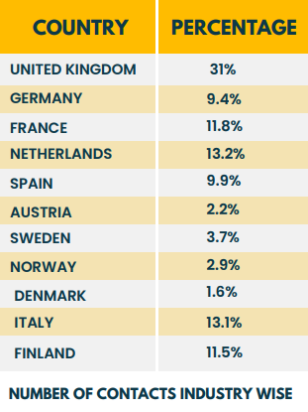
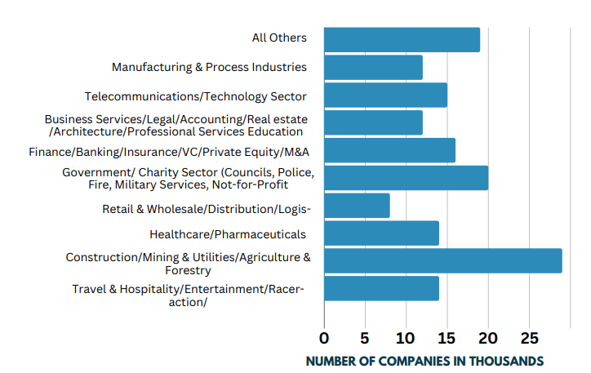
Industry Coverage

Slide 16
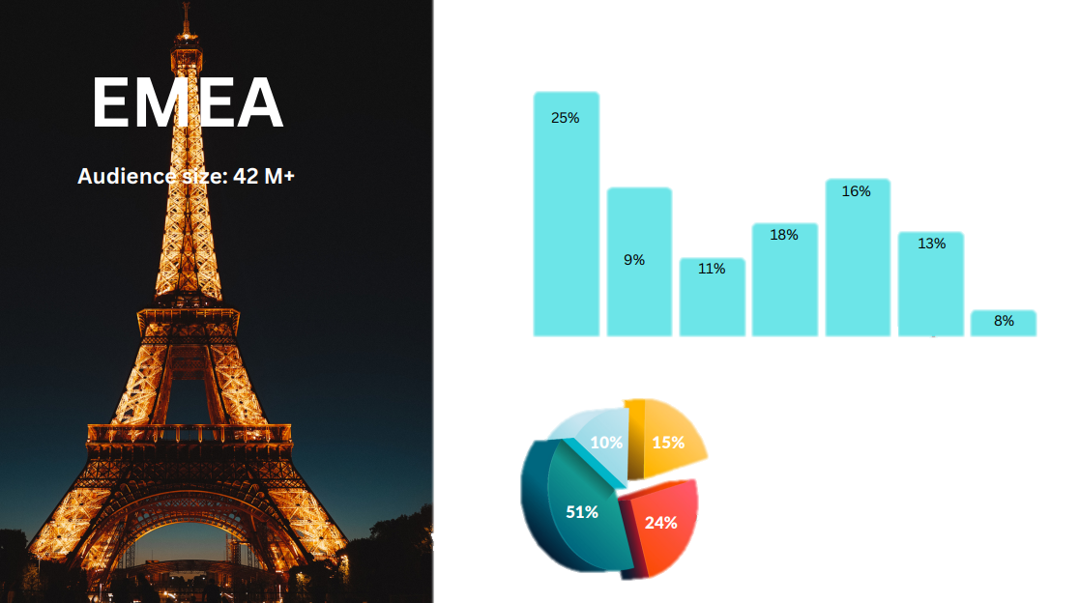
COMPANY SIZE
JOB LEVEL
C-LEVEL
DIRECTOR+
MANAGER LEVEL
OTHERS

Slide 17
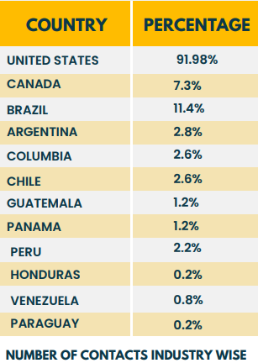
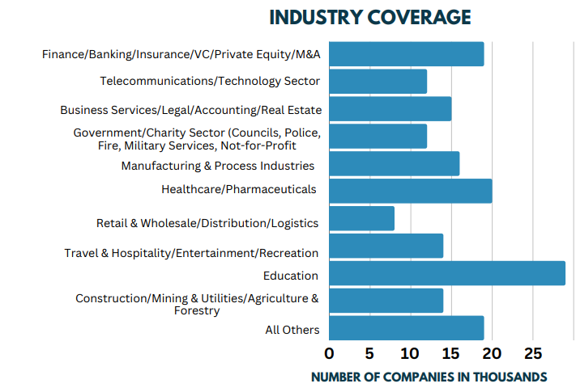
North America/ Latin America/ South America

Slide 18
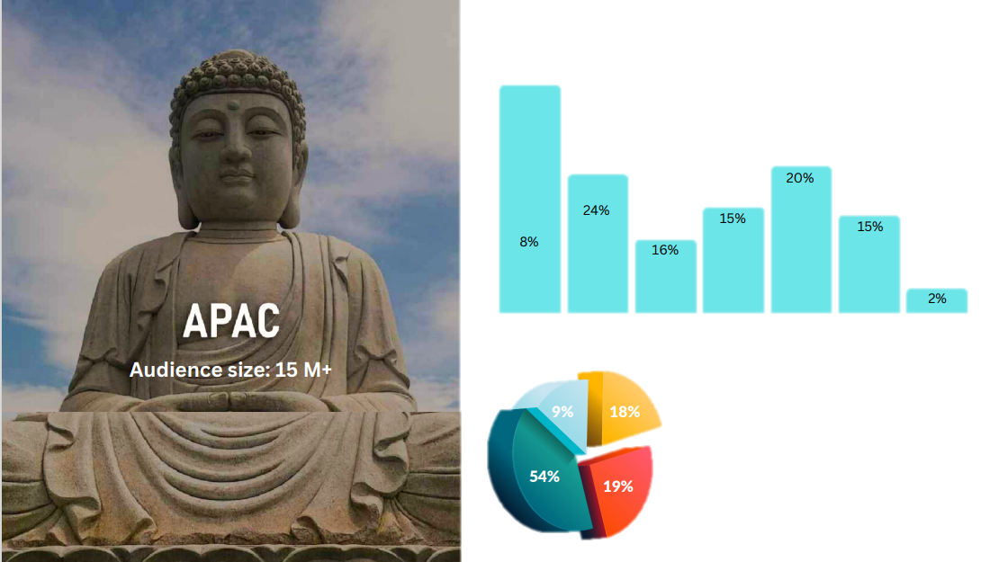
COMPANY SIZE
JOB LEVEL
C-LEVEL
DIRECTOR+
MANAGER LEVEL
OTHERS

Slide 19
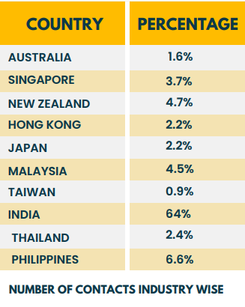
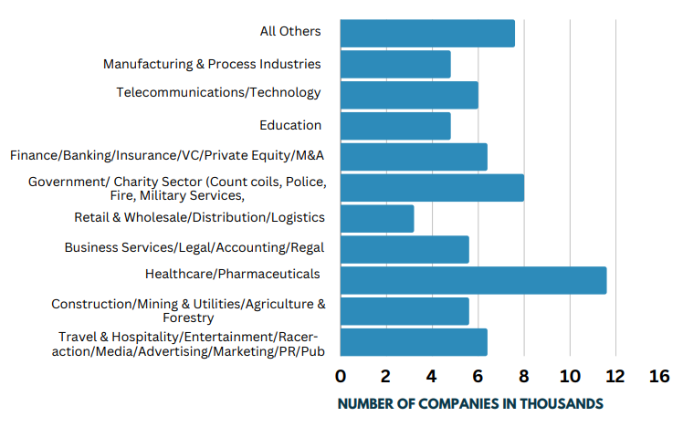
Industry Coverage

Slide 20



Our Marketing Solution Services
B2B Database Services
Account Profiling
B2B Database Mining or Extraction
B2B Database Research B2B Database Cleansing B2B Database Validation
B2B Marketing Solutions
Content Syndication MILA/MQL/SQL/SRLS
Appointment Generation BANT or CHAMP Leads Intent Leads
Event Support Services
Seminar & Webinar Invitations or Registrations Trade Show Visitor Invitations or Registrations Webcast Invitations or Registrations
Delegate Invitations or Registrations B2B Exhibition Booth Lead Generation

Slide 21
Demand Generation
Appointment
Setting
Email Append
Content
Syndication
Email Marketing
Our Services
Zion infotech Solution is a one stop solution when it comes to B2B Demand Generation / Lead Generation services. With our core team comprises of highly experienced demand generation professionals, we expertise into all the below verticals of B2B Demand Generation.
Pass Verification
Data Append
Webinar Registrations

Slide 22
Distribution for Telemarketing Leads
10%
30%
30%
30%
North America
Europe
Middle East & Africa
Rest of the World

Slide 23
Distribution for Email Marketing Leads
10%
25%
25%
40%
EMEA
APAC
North America
Rest of the World

Slide 24


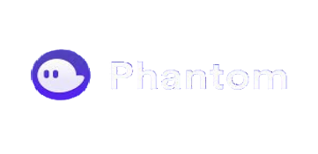


Our Utilization
We leverage premium subscriptions to platforms such as LinkedIn,
Leaderio, Apollo, Phantom, Slintel as our primary data sources
With a comprehensive approach, our audience reach extends to over 91 million records.
Within our internally stored dataset of 31 million records, a notable 11 million have actively opted in
Also, subscribed to our newsletters and emails, reflecting a strong engagement and interest from our audience.
We have the capability to deliver approximately 5,000 telemarketing leads and 50,000 email marketing leads on a monthly basis.

Slide 25
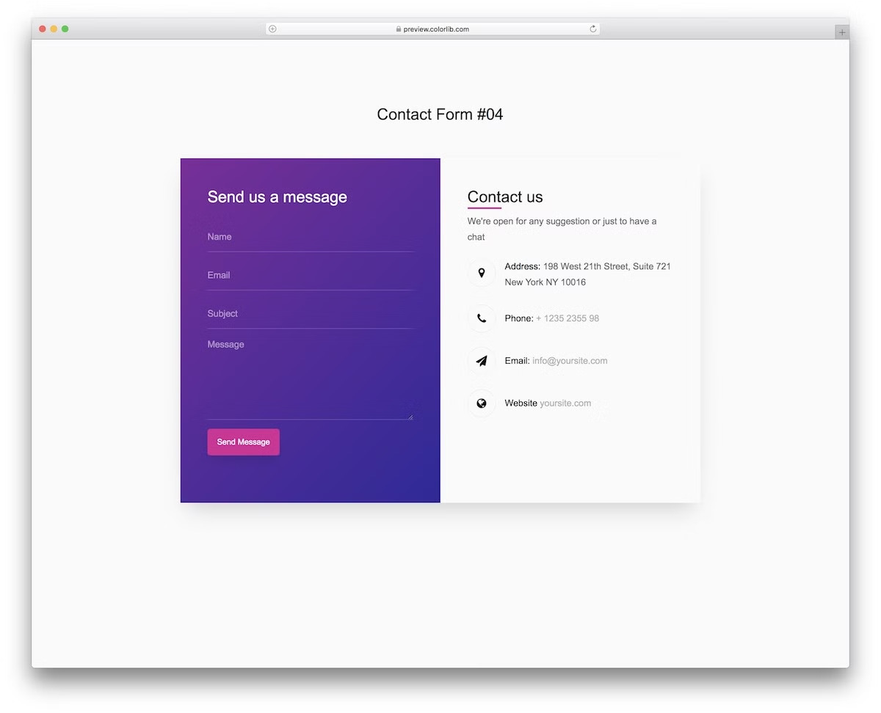
Contact Us
Reach out to Zion Infotech today to discuss your technology needs and learn how we can help your business thrive.
Address | Phone | Email
East court pune | 8168669936 | info@zioninfotech .com

